Slide 1
Network Programming Concepts
Client – Server Model For Communication using TCP/IP protocol Suite

Slide 2
Who is Client ?
A client is a program running on the local machine requesting service from a server.
It is a finite entity – i.e. started and terminated when service is complete.
It opens the communication channel using servers IP and well-know port address. This is active open.
It initiates request(s) and receives response(s).
After service is completed,it closes the communication channel with active close.

Slide 3
Who is Server ?
A server is a program running on the remote machine providing service to the clients.
It starts and waits for incoming requests from clients . This is called passive open.
It is an infinite entity.
It responds to request either iteratively or concurrently.

Slide 4
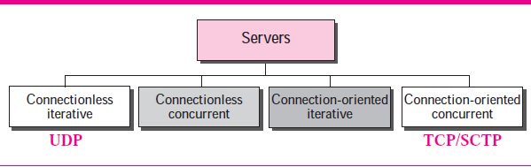
SERVER TYPES

Slide 5
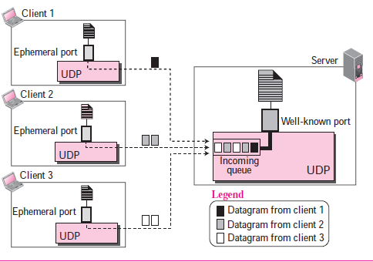
Connectionless Iterative Server

Slide 6
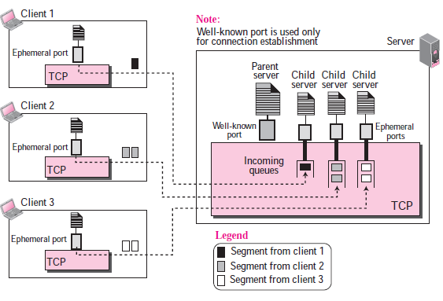
Connection-Oriented Concurrent Server

Slide 7
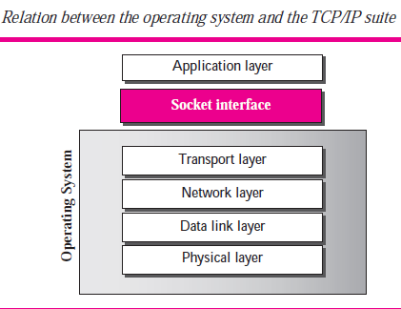

Slide 8
What is Socket Interface ?
A socket Interface is a set of instructions designed to fecilitate interaction between client-server processes.
These are usually API’s for an OS
Can be set of user defined functions/routines in firmware running in non os environment.
They allow to access services defined in the TCP/IP protocol suite /stack.

Slide 9
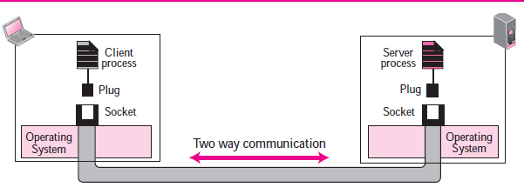
Concept of Socket

Slide 10
What is a socket ?
A socket is a virtual connection ,which servers as an endpoints for that connection between two processes (client and server)
A pair of similar/identical sockets , at each end of communication ,is needed.
The socket is the major IPC for Network/Internet applications using TCP/IP protocol suite
A Socket is a software data structure
Supports bi-directional (full-duplex) transmission

Slide 11
Origin of Socket Interface
Berkeley sockets (or BSD sockets) is a computing library with an application programming interface (API) for internet sockets and Unix domain sockets, used for inter-process communication (IPC).
As the API has evolved with little modification from a de facto standard into part of the POSIX specification, POSIX sockets are basically Berkeley sockets.

Slide 12
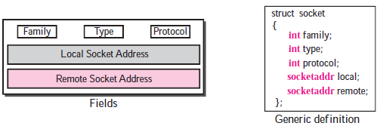
Socket data structure

Slide 13
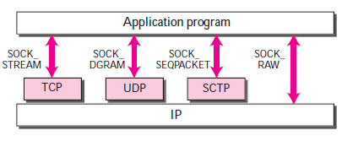
Socket types

Slide 14
List of socket API ’s on Linux/Unix/POSIX Compliant OSes
socket()—Get the File Descriptor!
bind()—What port am I on?
connect()—Hey, you!
listen()—Will somebody please call me?
accept()—"Thank you for calling to my port number for my service ."
send() and recv()—Lets us Talk Like This (TCP style)
sendto() and recvfrom()— OR Let us Talk in This way (UDP style)
close() - Let Both to say Bye Bye !

Slide 15
shutdown()-Let Both to say Bye Bye unless if there are other plans !
getpeername()—Who are you?
gethostname()—Who am I?
gethostbyname() – What is my IP?
gethostbyaddr() – What is my name ?
…. Many more

Slide 16
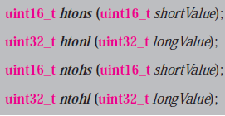
Byte Ordering Functions
Host byte order may be Little Endian/Big Endian
Network Byte Order is Big Endian

Slide 17
Address Conversion Function
To convert IPV4 dotted decimal presentation to a number to be stored in socket structure member.
And VICE-VERSA function are -
inet_addr();
inet_ntoa();
inet_pton();
inet_ntop();

Slide 18
List of headers for socket programming
<sys/types.h>
Predefined typedefs for Unix/Linux Os
<sys/socket.h>
Core BSD socket functions and data structures.
<netinet/in.h>
AF_INET and AF_INET6 address families and their corresponding protocol families PF_INET and PF_INET6. Widely used on the Internet, these include IP addresses and TCP and UDP port numbers.
<arpa/inet.h>
Functions for manipulating numeric IP addresses.
<netdb.h>
Functions for translating protocol names and host names into numeric addresses.
Searches local data as well as DNS.

Slide 19
Additional Header that may be required
<stdio.h>
<unistd.h>
<errno.h>
<strings.h>
<string.h>
<signal.h>
<sys/wait.h>
……and more depending on application

Slide 20
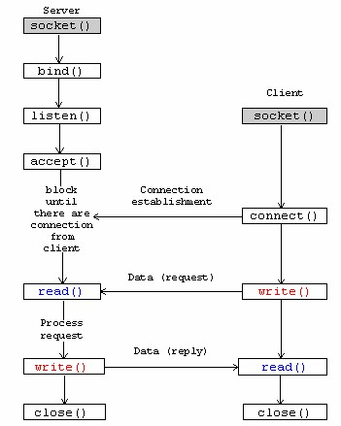
TCP Client – Server (Basic) Model
Connection termination

Slide 21
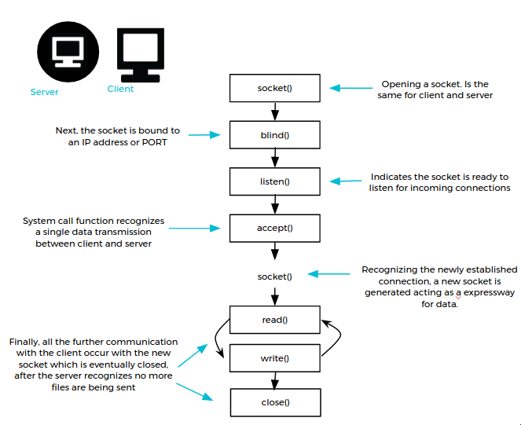

Slide 22
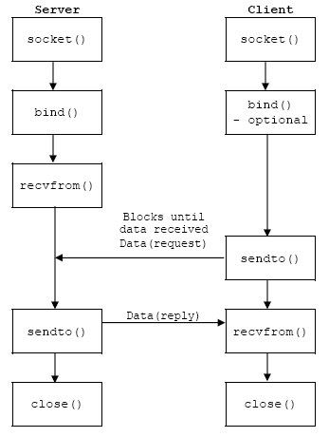
UDP Server – Client Model

Slide 23
Socket as a virtual connection between two processes
Host A
Socket + NW protocol
Host B
Process 1
Socket connection
Process 2
(virtual connection)
Information Hiding
Network Adapter Card
Network
(physical connection)

Slide 24
Socket as a client/server model
How can we distinguish
two connections?
The server should always be waiting for requests from the clients. A client makes a request, then the server responds.
Host C
Client 2
“PORT #”
socket
socket
Client 3
Host A
Server
Host B
Reply
Request
Client 1
Socket

Slide 25


Concept of “ports”
What is “port”?
It’s a logical connecting point at the transport-layer protocol.
If we do not have “ports”, what would happen?
Process B
Process A
Client Host X
Request
Request
Request (1)
Response
Response
146.163.147.81
Response with tag (2)
Request (3)
146.163.147.81
Internet
Internet
Response (4)
Server Host
IP Address
146.163.147.81
Client Host Y
Internet
Connect to
process B

Slide 26
Concept of “ports” (2)
If we use only IP address, we can’t select a destination
process at the destination host
Only one network application program
Can exist at a time
Process B
Process A
Client Host X
Request
Request
Request (1)
Response
Response
146.163.147.81
Response with tag (2)
Request (3)
146.163.147.81
Internet
Internet
Response (4)
Server Host
IP Address
146.163.147.81
Client Host Y
Internet
Connect to
process B

Slide 27
Concept of “ports” (3)
Host Computer
Process A
Process B
Process C
Process D
6055
9133
12133
1045
Transport Layer (TCP Layer)
ports
Network Layer (IP Layer)
Datalink Layer
LLC Layer
Physical Layer
MAC Layer
IP Address

Slide 28
TCP Client/Server Process Organization
API
Application Programming Interface
SERVER
“*” indicates a blocking function call.
socket()
CLIENT
socket()
bind()
listen()
1: Connection Request
*
connect()
*
accept()
Request Acknowledge
send()
*
recv()
2. Send a request
*
send()
recv()
3. Send reply
close()
close()

Slide 29
socket ( ) function
Returns socket ID on success
unsigned int socket_id = socket (AF_INET, SOCK_STREAM, 0);
“AF_INET” = Use IP protocol
“SOCK_STREAM” = Use TCP
Always 0

Slide 30
Step 2: bind( ) call
Port
After bind(_) call:
Port =
A logical connecting point at a host
for two communicating processes
using socket
6500
Server
Port Numbers:
0~1023: System Reserved
Port 21: FTP
Port 23: telnet
Port 80: HTTP
It connects a process to a specific port
1024 and above: available to users

Slide 31
bind ( ) function
Return code (< 0 if error)
Socket ID returned by socket function
int status = bind (socket_id, (struct sockaddr_in *) my_addr, sizeof(my_addr));
The sockaddr_in structure
to specify port # and IP address
of this machine (server machine)
The byte size of the
Sockaddr_in structure

Slide 32
The “sock_addr” structure
Step 1: You instantiate the structure
struct sockaddr_in my_addr; /* My (client) Internet address */
• • •
/* Set My(client's) IP Address ---------------------------------------- */
my_addr.sin_family = AF_INET; /* Address Family To Be Used */
my_addr.sin_port = htons (MY_PORT_NUM); /* Port number to use */
my_addr.sin_addr.s_addr = htonl (INADDR_ANY); /* My IP address */
Step 2: Fill up the components

Slide 33
Step 3: listen( ) call
listen( ) system call: prepare memory
buffer for incoming connections
After listen(_) call:
Buffer
Client request
6500
listen (socket_id, number_of_connection);
Server
We need to specify how many
connection requests should be
held in the buffer when SERVER
is busy (can’t accept a request).

Slide 34
listen ( ) function
Return code (< 0 if error)
Socket ID returned
by socket function
int status = listen (socket_id, 3);
The size of the connection request buffer

Slide 35
Step 4 - Part 1: accept( ) call
accept ( ) function is
a blocking function
After accept(_) call:
6500
Client
Server
The server process accepts a request from a client

Slide 36
Step 4 - Part 2: accept( ) call
The accept(_) call returns another port number and establish another connection
③ Server needs to close the first
6500
Client
Server
7100
① OS duplicates the socket connection
② A new port is assigned by OS

Slide 37
accept ( ) function
duplicated socket ID (< 0 if error)
Socket ID returned
by socket function
unsingned int child_sock = accept (socket_id, (struct sockaddr_in *) client_addr,
sizeof (client_addr);
The sockaddr_in structure for a connecting client
The size of the sockaddr_in structure for connecting client

Slide 38
Step 5: read( ) and write( ) call
write (or send)
read (or recv)
6500
Client
Server
7100
Data transmission
The server and client communicate using the second socket

Slide 39
recv ( ) function
On success, the number of bytes received
Return code (< 0 if error)
Socket ID returned
by socket function
int status = recv (socket_id, in_buffer, MAX_BUFFER_SIZE, 0);
The input (receive) buffer
as a character string
Example: char in_buffer [MAX_BUFFER]
The maximum buffer size
Always 0

Slide 40
send ( ) function
On success, the number of bytes actually sent
Return code (< 0 if error)
Socket ID returned
by socket function
int status = send (socket_id, out_buffer, MAX_BUFFER_SIZE, 0);
The output (send) buffer
as a character string
The maximum buffer size
Always 0

Slide 41
Step 6: close ( ) call
6500
Client
Server
7100
Close the second socket and leave the first socket for next client

Slide 42
close ( ) function
Return code (< 0 if error)
int status = close (socket_id);
Socket ID returned
by socket function

Slide 43
Step 7: Go back to accept( ) call
6500
Client
Server
The server process goes back to the accept call

